Slide 1

R语言做图
王志恒
Zhiheng.wang@pku.edu.cn
2021.10.13 @ PKU, China
Department of Ecology
College of Urban & Environmental Sciences
Peking University

Slide 2
How to make figures using R?
Basic functions for making figures
Scatter plots and other figures: plot(x, y, xlab, ylab, xlim, ylim), or plot(y~x)
Histograms: hist(x, …)
Bar plots: barplot(height, beside=FALSE)
Box plots: boxplot(x), or boxplot(y~x)

Slide 3
How to make figures using R?
Draw extra things on a figure
Draw points: points(x, y, pch, col, cex), or points(y~x)
Draw lines: lines(x, y, lty, col, lwd), or lines(y~x)
Draw a straight line with specific intercept and slope: abline(a, b, lty, col, lwd)
## a is the intercept, and b, the slope
Draw polygons:

Slide 4
How to make figures using R?
Functions for making figure better
Put text onto the figure: text(x, y, labels)
mtext()
Put legend onto the figure: legend(x, y, legend, color, pch, lty, …)
Generate a new window: windows(width, height, …)
Modify the options for drawing figures: par(mar, mfrow, mgp, …)
Show error bars
You may need to do some coding

Slide 5
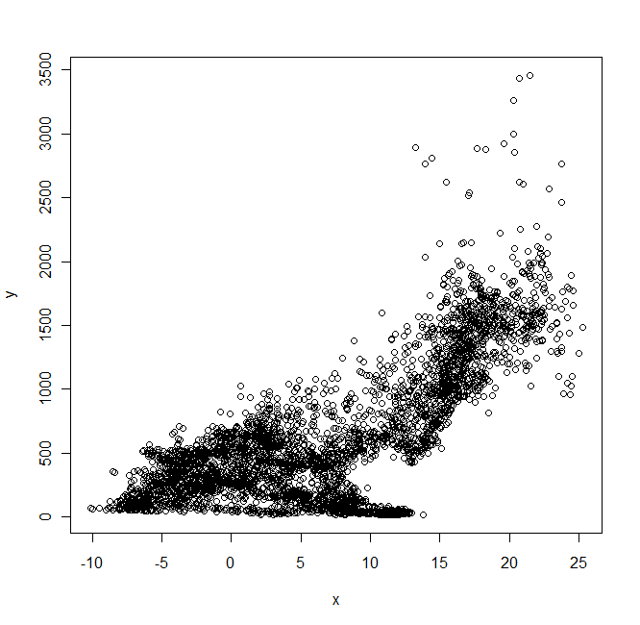
Examples to make figures: scatter plots
Import the data
> setwd("E:/My_Teaching/R_Group")
> d.clim <- read.csv(file = "ClimateChina.csv", header=T)
Simple scatter plot
> x <- d.clim$Bio1 ## mean annual temperature
> y <- d.clim$Bio12 ## mean annual precipitation
> plot(x, y)
> plot(y~x)

Slide 6
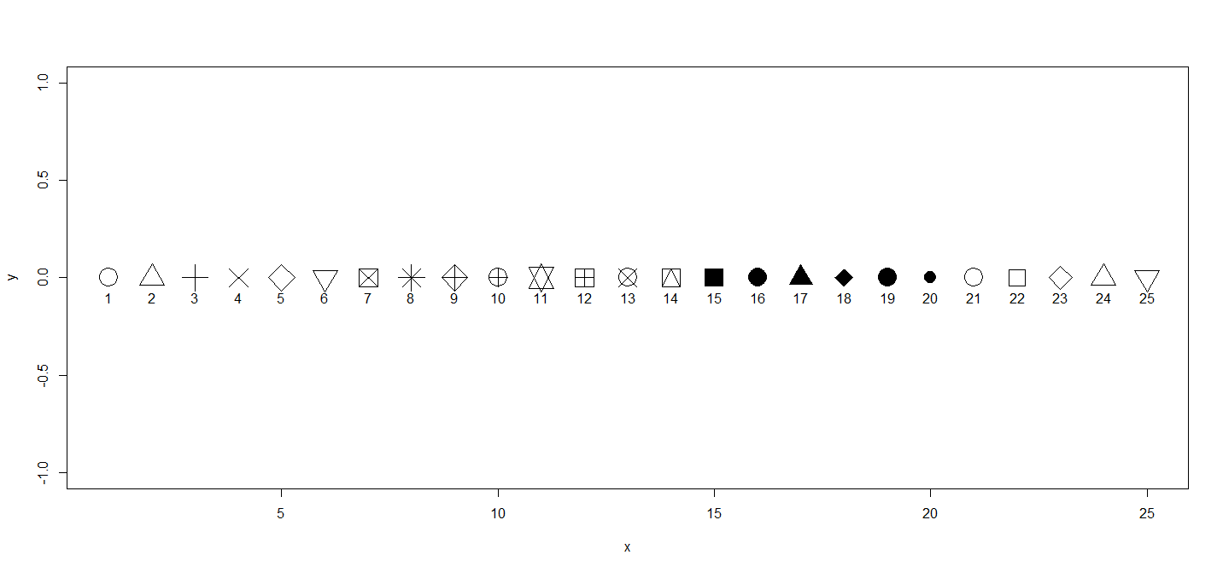
Examples to make figures: scatter plots
Use different symbols: pch argument

Slide 7
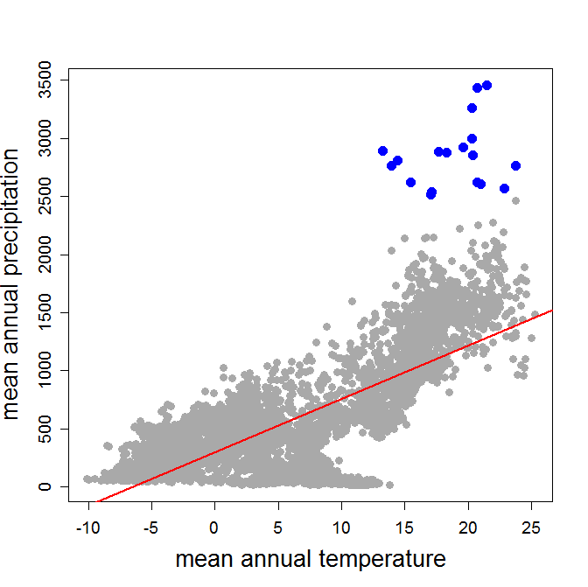
Examples to make figures: scatter plots
The relationship between mean annual temperature and precipitation
Wang et al. (2011) Proceedings B

Slide 8
Examples to make figures: scatter plots
Make the figure look better
plot(y~x,
## axes lables
xlab="mean annual temperature", ylab="mean annual precipitation",
## change the symbol
pch=19, col="darkgray",
## modify the size of symbols and text
cex=1.2, cex.axis=1.2, cex.lab=1.7)
## draw a linear regression line
## linear regression model
m <- lm(y~x)
## extract the intercept and slope
a <- summary(m)$coefficient[1,1]; b <- summary(m)$coefficient[2,1]
abline(c(a,b),
## change color and weight of the line
col="red", lwd=2)
## emphasize the points with precipitation > 2500 mm
subset <- y>2500
points(y~x, subset=subset, cex=1.5, col="blue", pch=19)
Wang et al. (2011) Proceedings B

Slide 9
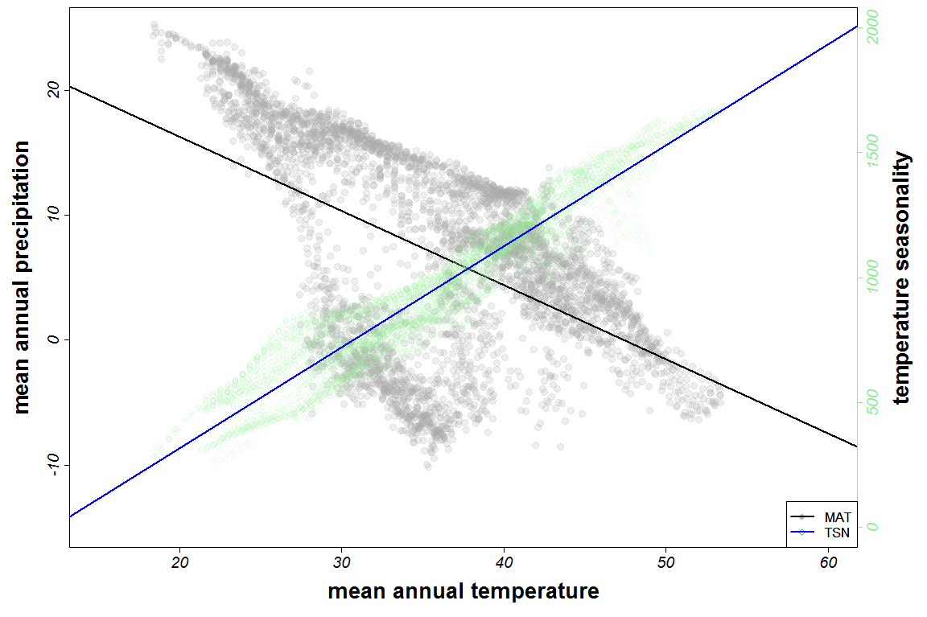
Make a figure suitable for publication
Show latitudinal gradients in both mean annual temperature and temperature seasonality in the same figure
Wang et al. (2011) Proceedings B

Slide 10
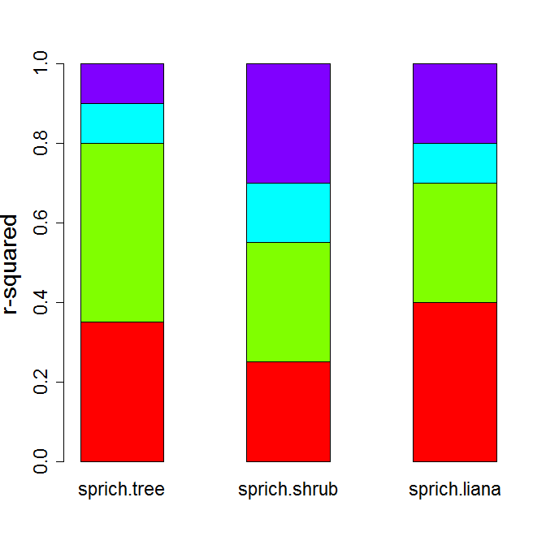
Examples to make figures: bar plot
## r-square partitioning
r2 <- as.matrix(data.frame(sprich.tree = c(0.35, 0.45, 0.10, 0.10),
sprich.shrub = c(0.25, 0.30, 0.15, 0.30),
sprich.liana = c(0.40, 0.30, 0.10, 0.20)))
barplot(height=r2,
width = 1, space = 1, beside = F,
col = rainbow(4), ylab = "r-squared",
cex.lab = 1.7, cex.axis = 1.4, cex.names = 1.4)

Slide 11
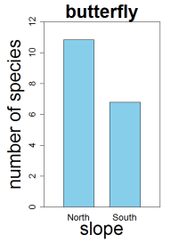
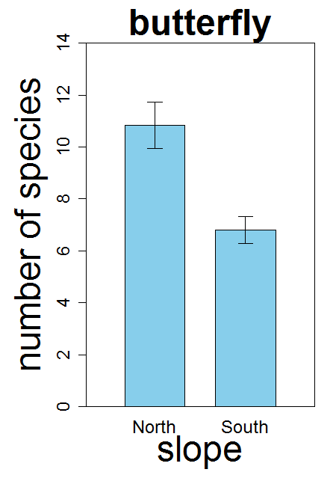
Examples to make figures: bar plot
Make your graphs simple.
Both the x- and y-axis should have a label that can be read
Use the largest font possible because often the graph will have to be drastically shrunk for publication.
Use contrasting colors.
## to define how the figure looks
par()
## to plot the figure
barplot()

Slide 12
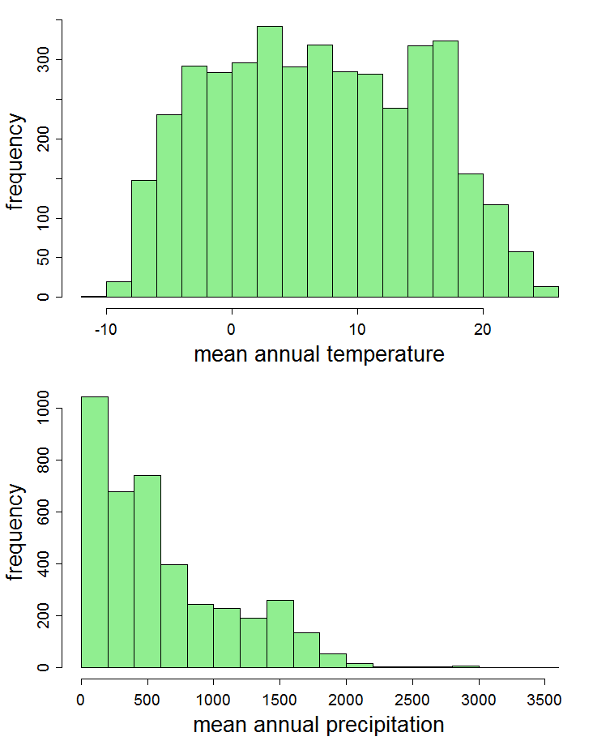
Examples to make figures: histograms
## open a new graphic window
windows(width = 8, height = 10, pointsize = 12)
## modify the default setting of the figure region
par(
mfrow = c(2, 1), ## number of panels
mar = c(4,4,1,1), ## margin
tck = -0.02, ## tick length
mgp = c(2.5, 0.8, 0) ## distance between axes and axes labels
)
hist(x,
main="", xlab = "mean annual temperature", ylab = "frequency", ## labels
cex.axis = 1.2, cex.lab = 1.7, col="lightgreen", border="black” ## size of labels and texts, and color
)
hist(y, main="", xlab = "mean annual precipitation", ylab = "frequency",
cex.axis = 1.2, cex.lab = 1.7, col="lightgreen", border="black”)

Slide 13
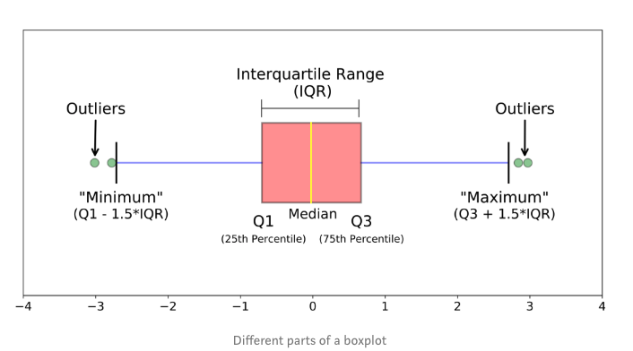
Examples to make figures: box plot

Slide 14
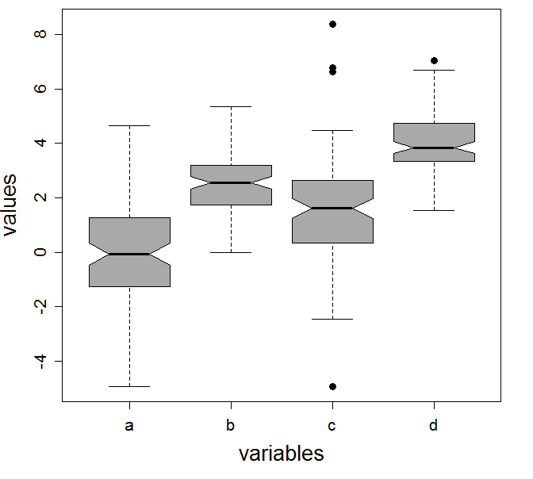
Examples to make figures: box plot
## generate an example data frame, containing four columns
d1 <- data.frame(
a = rnorm(100, sd = 1.8),
b = rnorm(100, mean=2.5, sd = 1),
c = rnorm(100, mean = 1.5, sd = 2),
d = rnorm(100, mean = 4, sd = 1))
## box plot for the example data
boxplot(d1, notch = T, col= "darkgray",
ylab="values", xlab="variables", ## axis labels
cex.axis=1.3, cex.lab=1.7, ## size for axis labels
pch=19, cex=1.2) ## symbol type and size for outliers
25%, 75%分位数
上、下边缘：Q1 – 1.5

Slide 15
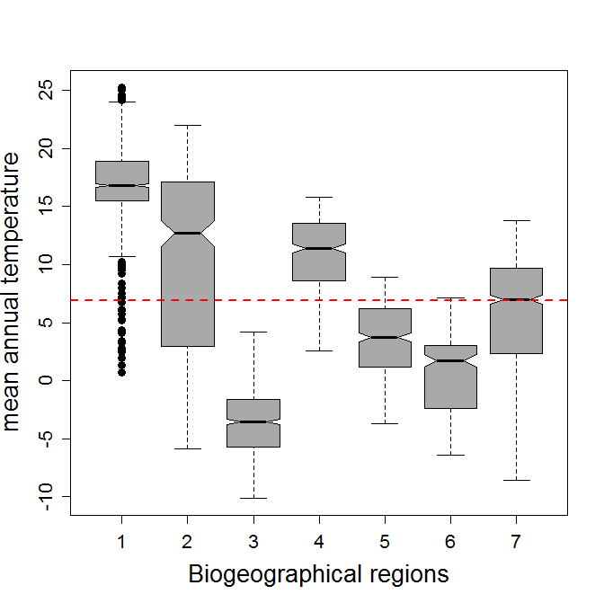
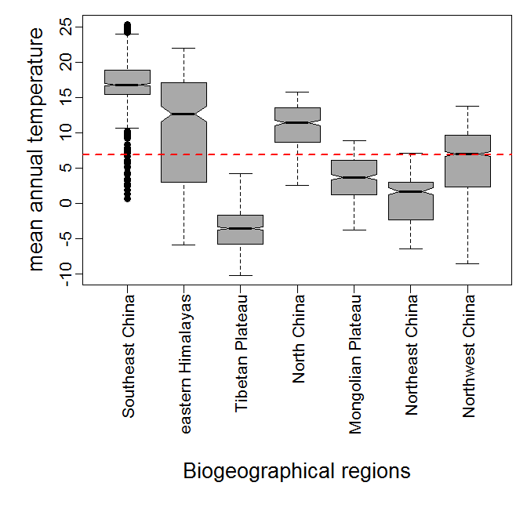
Examples to make figures: box plot
## box plot for the mean annual temperature of different
## biogeographical regions in China
boxplot(Bio1~Biome, data = d, ylab = "mean annual temperature",
xlab = "Biogeographical regions", notch = T, col= "darkgray",
pch=19, cex=1.2, cex.axis=1.3, cex.lab=1.7)
## draw a line showing the national mean value of MAT
lines(x=c(0,10),y=rep(mean(d$Bio1),times=2), col="red", lty=2, lwd=2)

Slide 16
Examples to make figures: composed figures
par(mfrow=c(2,2))
par(mfcol=c(2,2))

Slide 17
Examples to make figures: composed figures
layout()

Slide 18
Examples to make figures: composed figures
Show the relationships between the proportion of tooth-leaf species and climate variables.
Li Y et al. (2016) Global Ecology and Biogeography, 25, 1401-1415.

Slide 19
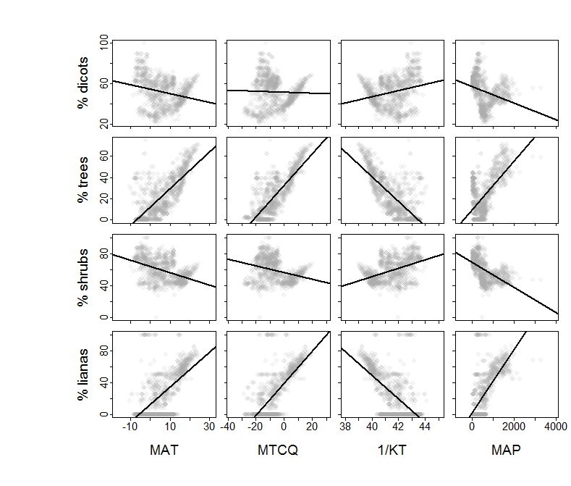
Examples to make figures: composed figures
Show the relationships between the proportion of tooth-leaf species and climate variables.

Slide 20
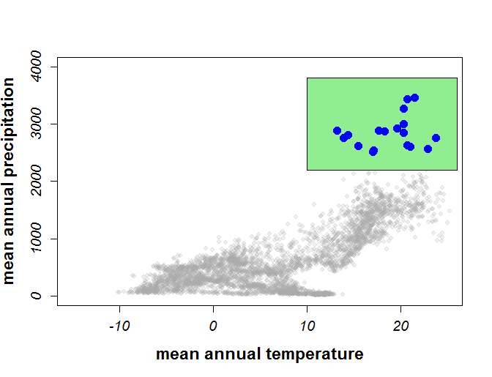
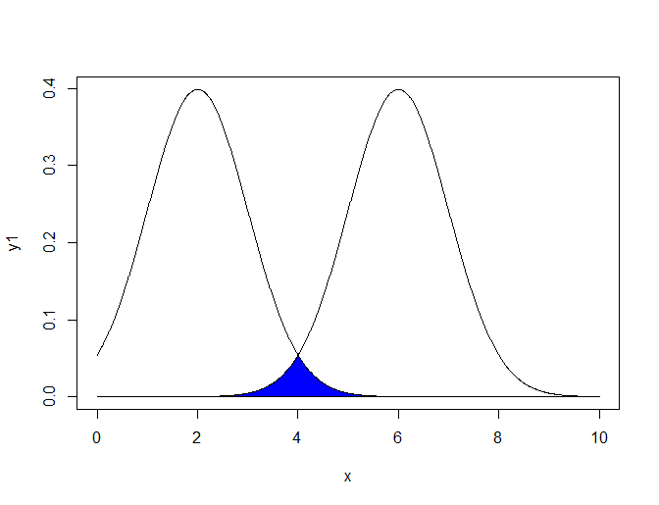
Examples to make figures: correlation plot

Slide 21
谢谢！

